Slide 1
Prepare data in Power BI Desktop
aka.ms/PL300-2

Slide 2
Agenda
Get data in Power BI
Retrieve data from various data sources
Select storage mode
Resolve import errors
Clean, transform, and load data in Power BI
Resolve inconsistencies and data quality issues
Profile data for better insights
Apply data shape transformations

Slide 3
Get data in Power BI

Slide 4
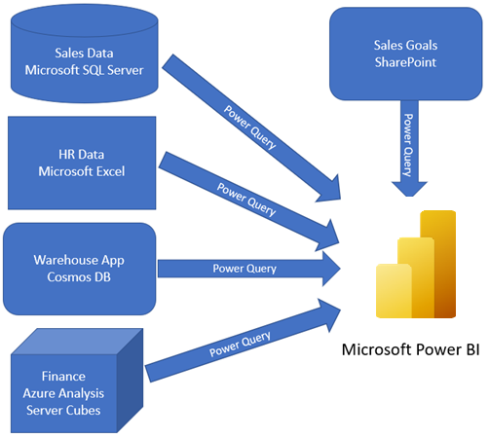
Combine all data into a single dataset
Notes:
Like most of us, you work for a company where you are required to build Microsoft Power BI reports. The data resides in several different databases and files. These data repositories are different from each other, some are in Microsoft SQL Server, some are in Microsoft Excel, but all the data is related.
When connecting to data, the default behavior is that the data is imported into your Power BI Desktop (.pbix) file. You aren’t directly affecting the underlying data with Power BI. We’ll cover storage modes in the next section.

Slide 5
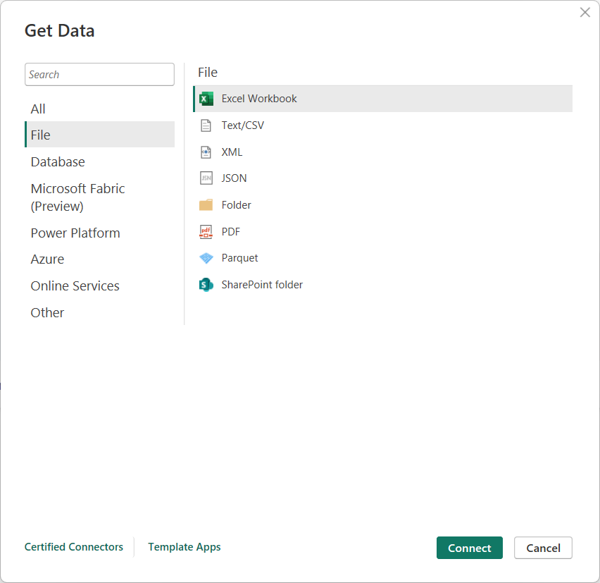
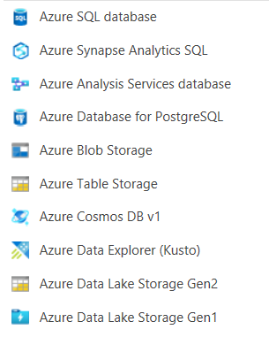
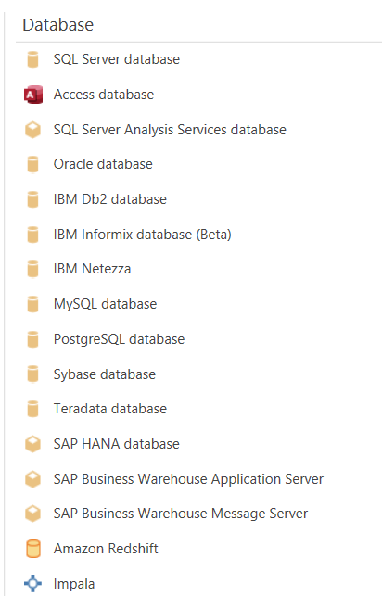
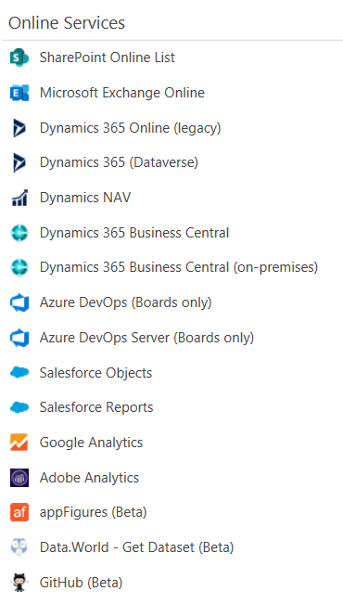
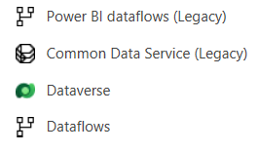
Get data from a wide variety of sources
Notes:
<BUILD slide>
Power BI offers over 190 connectors to a wide variety of data sources. These are some of the most common, but not inclusive of all.
Certain connectors have different initial configuration, but they all connect to data and allow you to turn it into meaningful insights.
First, we see the Get Data dialog box with File grouping selected. Notice csv and Excel files here, as well as folders.
<CLICK>
Database top connectors
<CLICK>
Power Platform connectors
<CLICK>
Azure top connectors
<CLICK>
Online services top connectors
Suggestion: ask students which data sources they are most familiar with.

Slide 6
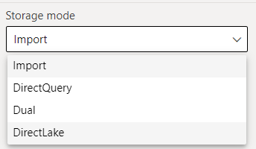
Select a storage mode
Storage mode affects
Available transformations
Report performance
*Not all sources support all modes
Notes:
The different types of storage modes you can choose from:
Import: The Import mode allows you to create a local Power BI copy of your datasets from your data source. Imported datasets support all transformations, unlike DirectQuery, which is another consideration when choosing which mode to use.
Import supports scheduled dataset refresh, and is the best choice for reports that can tolerate 30 minutes or more before refresh.
This is the preferred method and supports all transformations.
DirectQuery: Create a direct connection to the data source, ensuring your data is not cached and you are always viewing the most up-to-date data. This is dependent on the data source (typically only available for relational databases), and the performance of the report and database are directly correlated. Be sure to communicate with your database administrator before using DirectQuery to ensure it’s supported.
Dual (Composite): Identify some data to be directly imported and other data that must be queried.
- DirectLake is essentially DQ for Microsoft Fabric data sources

Slide 7
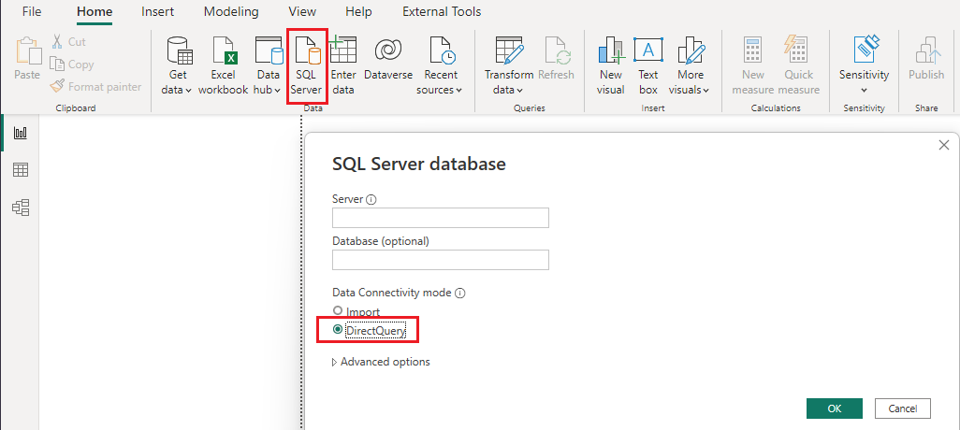
Introduction to DirectQuery
Notes:
When you use the DirectQuery method, the overall user experience depends heavily on the performance of the underlying data source. Slow query response times will lead to a negative user experience and, in the worst-case scenarios, queries might time out.
The number of users who are opening the reports at any one time will impact the load that is placed on the data source. For example, if your report has 20 visuals in it and 10 people are using the report, 200 queries or more will exist on the data source because each visual will issue one or more queries.
Unfortunately, the performance of your Power BI model will not only be impacted by the performance of the underlying data source, but also by other uncontrollable factors, such as:
Network latency; faster networks return data quicker.
The performance of the data source's server and how many other workloads are on that server. For example, consider the implications of a server refresh taking place while hundreds of people are using the same server for different reasons.
Therefore, using DirectQuery poses a risk to the quality of your model's performance. To optimize performance in this situation, you need to have control over, or access to, the source database.

Slide 8
Implications of using DirectQuery
Benefits
Limitations
Frequently changing data
Need near real-time
Large data volumes
Multi-dimensional data
Dependent on data source performance
Security between source and destination
Limited modeling capabilities
Limited transformation features
Notes:
It is best practice to import data into Power BI Desktop, but your organization might need to use the DirectQuery data connectivity mode.
If your organization needs to use DirectQuery, you should clearly understand its behavior within Power BI Desktop and be aware of its limitations. You will then be in a good position to take action to optimize the DirectQuery model as much as possible.
When you use DirectQuery to connect to data in Power BI Desktop, that connection behaves in the following way:
DirectQuery connects directly to data.
Only the schema is imported.
Visuals only fetch data from the source when built.
DirectQuery is only near real-time due to resources and caching.
Refresh visuals to see underlying data updates.
Requires data gateway for on-premises data sources.
Dashboards have scheduled auto-refresh, and can be manually refreshed.

Slide 9
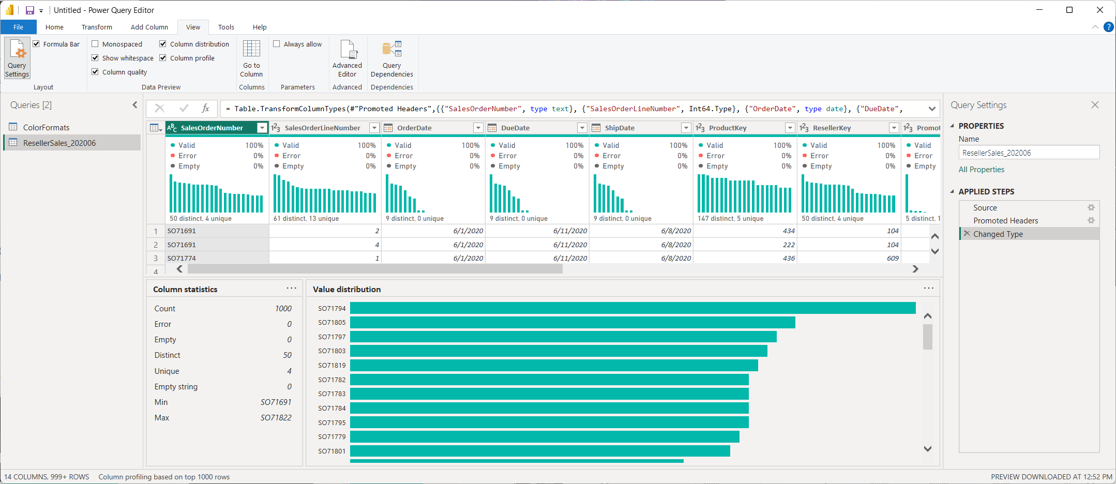
Data profiling options in Power Query Editor
Notes:
Profiling data is about studying the nuances of the data: determining anomalies, examining and developing the underlying data structures, and querying data statistics such as row counts, value distributions, minimum and maximum values, averages, and so on. This concept is important because it allows you to shape and organize the data so that interacting with the data and identifying the distribution of the data is uncomplicated, therefore helping to make your task of working with the data on the front end to develop report elements near effortless.
Understand data structures
Before you begin examining the data in Power Query Editor, you should first learn about the underlying data structures that data is organized in. Profiling data occurs either prior to or in parallel to data shaping. Understanding which tables are related is important so you can configure relationships in the data modelling step.
Find data anomalies and data statistics
After you have created a connection to a data source and have selected Transform Data, you are brought to Power Query Editor, where you can determine if anomalies exist within your data. Data anomalies are outliers within your data.
Column distribution shows you the distribution of the data within the column
Column profile gives you more details about the data in the column, including basic statistics.
The Value distribution graph tells you the counts for each unique value in that specific column.
Column Statistics will also include how many zeroes and null values exist, along with the average value in the column, the standard deviation of the values in the column, and how many even and odd values are in the column.

Slide 10
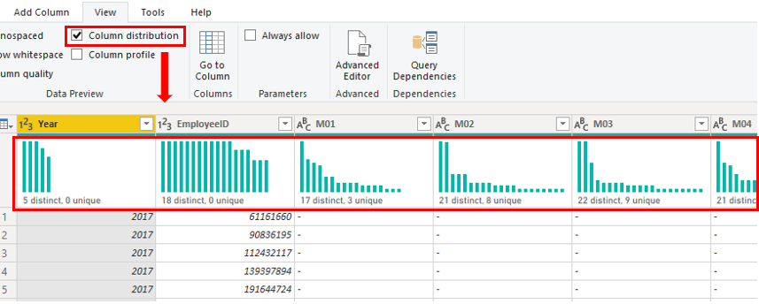
Determine cardinality of a column
Notes:
Cardinality is a term that is used to describe the uniqueness of the values in a column. Cardinality is also used in the context of the relationships between two tables, where it describes the direction of the relationship.
Identify cardinality levels in columns
Previously, when you used Power Query Editor to analyze the metadata, the Column distribution option on the View tab displayed statistics on how many distinct and unique items were in each column in the data.
Distinct values count - The total number of different values found
Unique values count - The total number of values that only appear once
A column that has a lot of repeated values in its range (distinct count is high) will have a low level of cardinality. Conversely, a column that has a lot of unique values in its range (unique count is high) will have a high level of cardinality.
Lower cardinality leads to more optimized performance, so you might need to reduce the number of high cardinally columns in your dataset.
Improve performance by reducing cardinality levels
Power BI Desktop offers different techniques that you can use to help reduce the data that is loaded into data models, such as summarization. Reducing the data that is loaded into your model will improve the relationship cardinality of the report. For this reason, it is important that you strive to minimize the data that will be loaded into your models. This case is especially true for large models, or models that you anticipate will grow to become large over time.
Perhaps the most effective technique to reduce a model size is to use a summary table from the data source. Where a detail table might contain every transaction, a summary table would contain one record per day, per week, or per month. It might be an average of all of the transactions per day, for instance.

Slide 11
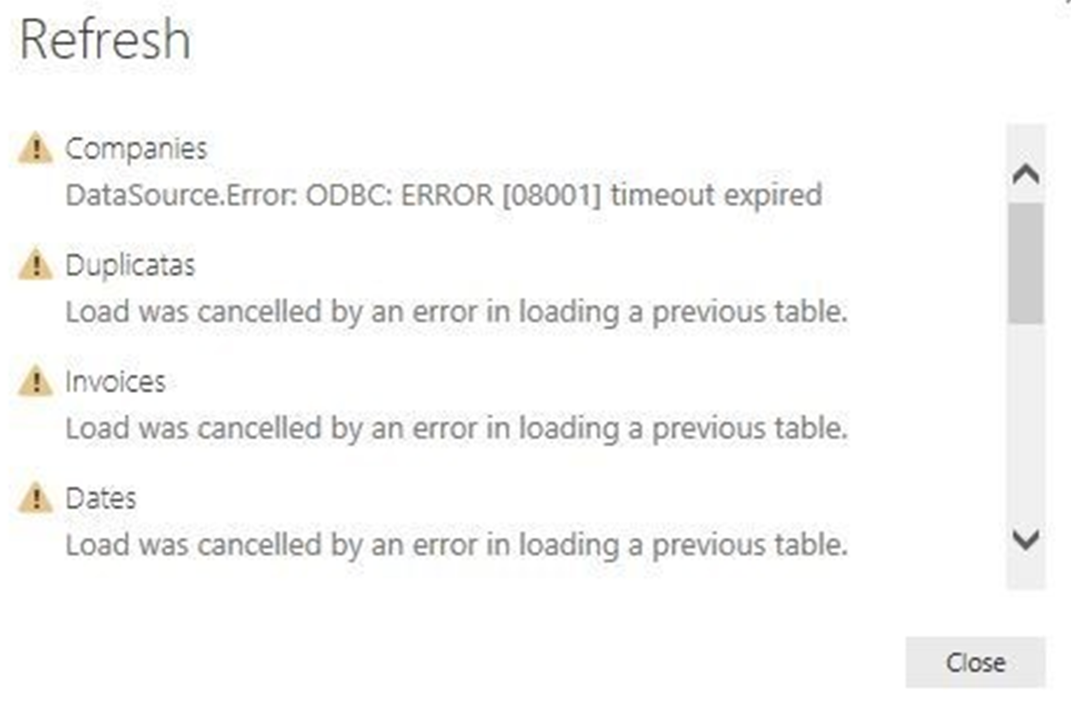
Data import errors
Possible data load errors:
Query Timeout
Couldn’t find data formatted as a table
Could not find file
Data type errors
Notes:
While importing data into Power BI, you may encounter errors resulting from factors such as:
Power BI imports from numerous data sources.
Each data source might have dozens (and sometimes hundreds) of different error messages.
Other components can cause errors, such as hard drives, networks, software services, and operating systems.
Data can often not comply with any specific schema.
Details:
Query timeout: Hardware resources are being constrained by concurrent users using the same data.
Timeout expired: Indicates that you've pulled too much data according to your organization's policies.
Couldn’t find data: Power BI expects to find data formatted as a table from Excel.
Could not find file: Caused by the file moving locations or the permissions to the file changing.
Data type errors: An error in interpreting the data type in Power BI. The resolution to this error is unique to the data source.
This list isn’t exhaustive, but shows common errors encountered.

Slide 12
DEMO
Get data in Power BI Desktop

Slide 13

Lab: Prepare data in Power BI Desktop
This lab is designed to introduce you to Power BI Desktop application and how to connect to data and how to use data preview techniques to understand the characteristics and quality of the source data.
Open Power BI Desktop
Connect to source data
Preview source data
Use data profile tools

Slide 14
Knowledge check: get data
When connecting to a SQL Server database to get data, what language should you use to extract data?
DAX
T-SQL
MDX
How many rows are sampled in Power Query Editor by default?
All
1000
100
What can you do to improve performance when you're getting data in Power BI?
Remove unnecessary columns and rows
Export database files to CSV to load
Combine date and time columns into a single column

Slide 15
Clean, transform, and load data

Slide 16
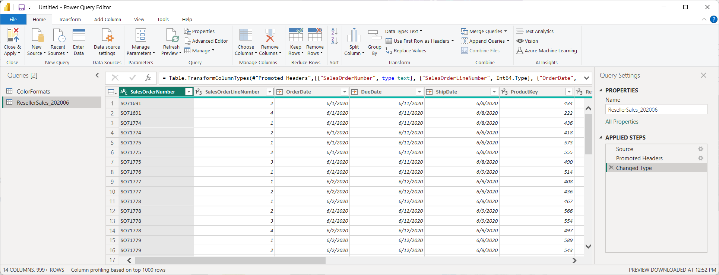
Transform data with Power Query Editor
Notes:
Get started with Power Query Editor
To start shaping your data, open Power Query Editor by selecting the Transform data option on the Home tab of Power BI Desktop. When you work in Power Query Editor, all steps that you take to shape your data are recorded. Then, each time the query connects to the data source, it automatically applies your steps, so your data is always shaped the way that you specified.
From here, you can see the queries pane on left and the Query settings pane on the right.
Tip: queries are just tables before you complete your data transformations!
Queries pane allows you to group, rename, remove, and disable/enable load for your queries.
Query settings also allows renaming and shows all of the steps for the query in the order they were completed. You can right-click a step and add a description, so you can record why the change was made, such as “excluding a specific column”, “changing data type to support leading zeroes”, etc.

Slide 17
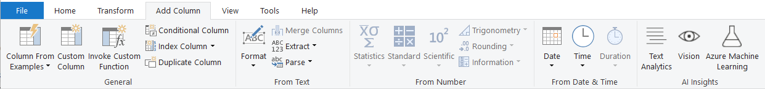
Common transformations
Transform columns, add new, split, extract, and more
Notes:
Common transformations in Power Query Editor include renaming, removing columns, formatting, etc. in the Transform ribbon. We won’t cover them all, but we suggest exploring them all, to know what options are available.
The first step in shaping your initial data is to identify the column headers and names within the data and then evaluate where they are located to ensure that they are in the right place.
You can also Add columns based on existing columns, create a custom column using M language, or convert date/time columns to calculate age, duration in years, etc.
Choose columns/Go to Column allows you to select which columns you want. Don’t keep ones you don’t need. If you have a date/time, but only need the date or time, change the data type to match and reduce the size of your dataset.
When you choose columns, you’re explicitly naming them so new columns in the underlying dataset will not change what choices you have. This is different from just removing a specifically named column.
When you add columns, the default data type is ABC123. After completing column transformations, ALWAYS make sure your data types are correct.

Slide 18
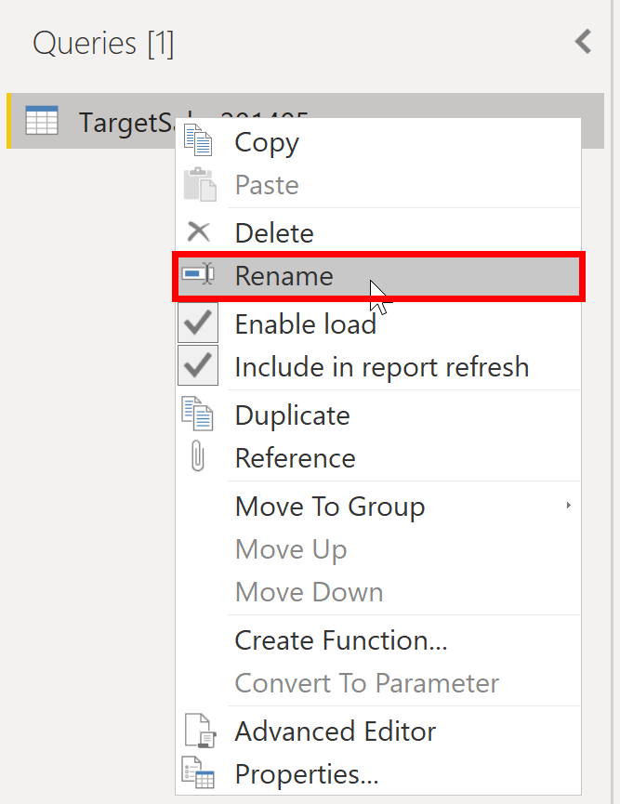
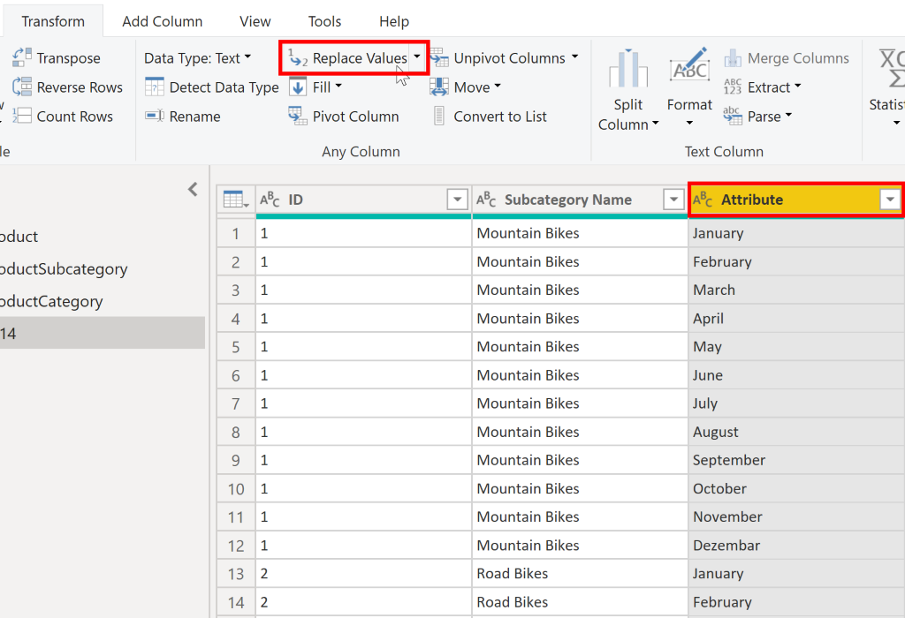
Choose user-friendly values
Notes:
When you import data from multiple sources into Power BI Desktop, the data retains its predefined table and column names. You might want to change some of these names so that they are in a consistent format, easier to work with, and more meaningful to a user. You can use Power Query Editor in Power BI Desktop to make these name changes and simplify your data structure.
Rename a query
It's good practice to change uncommon or unhelpful query names to names that are more obvious or that the user is more familiar with.
Replace values
You can use the Replace Values feature in Power Query Editor to replace any value with another value in a selected column.
Replace null values
Occasionally, you might find that your data sources contain null values.
Remove duplicates
You can also remove duplicates from columns to only keep unique names in a selected column.
Best practices for naming tables, columns, and values
A best practice is to give your tables, columns, and measures descriptive business terms and replace underscores ("_") with spaces. Be consistent with abbreviations, prefaces, and words like "number" and "ID." Excessively short abbreviations can cause confusion if they are not commonly used within the organization.

Slide 19
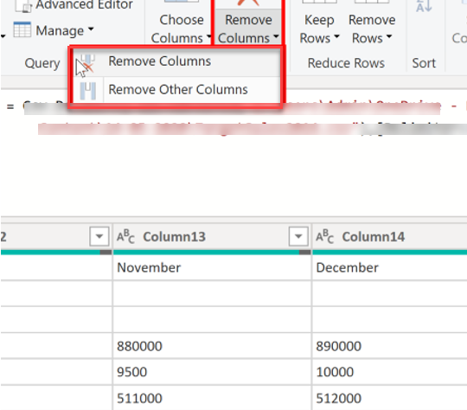
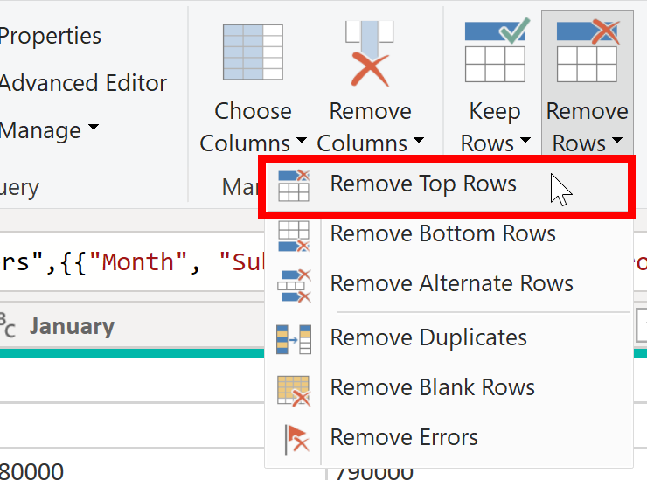
Shaping table structure
Notes:
With Power BI Desktop, you can connect to many different types of data sources, then shape the data to meet your needs, enabling you to create visual reports to share with others. Shaping data means transforming the data: renaming columns or tables, changing text to numbers, removing rows, setting the first row as headers, and so on.
Promote headers
When a table is created in Power BI Desktop, Power Query Editor assumes that all data belongs in table rows. However, a data source might have a first row that contains column names, which is what happened in the previous SalesTarget example. To correct this inaccuracy, you need to promote the first table row into column headers.
Rename columns
The next step in shaping your data is to examine the column headers. You might discover that one or more columns have the wrong headers, a header has a spelling error, or the header naming convention is not consistent or user-friendly.
Remove top rows
When shaping your data, you might need to remove some of the top rows, for example, if they are blank or if they contain data that you do not need in your reports.
Remove columns
A key step in the data shaping process is to remove unnecessary columns. It is much better to remove columns as early as possible. Removing columns at an early stage in the process rather than later is best, especially when you have established relationships between your tables.

Slide 20
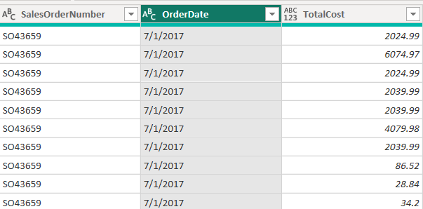
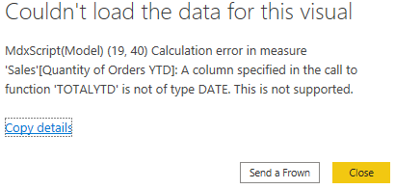
Evaluate and change column data types
Notes:
When you import a table from any data source, Power BI Desktop automatically starts scanning the first 1,000 rows (default setting) and tries to detect the type of data in the columns. Some situations might occur where Power BI Desktop does not detect the correct data type. Where incorrect data types occur, you will experience performance issues.
A best practice is to evaluate the column data types in Power Query Editor before you load the data into a Power BI data model. If you determine that a data type is incorrect, you can change it. You might also want to apply a format to the values in a column and change the summarization default for a column.
Implications of incorrect data types
Incorrect data types will prevent you from creating certain calculations, deriving hierarchies, or creating proper relationships with other tables.
For example, if you try to calculate the Quantity of Orders YTD, you will get the following error stating that the OrderDate column data type is not Date, which is required in time-based calculations.
Change the column data type
You can change the data type of a column in two places: in Power Query Editor and in the Power BI Desktop Report view by using the column tools. It is best to change the data type in the Power Query Editor before you load the data.
As with any other changes that you make in Power Query Editor, the change that you make to the column data type is saved as a programmed step. This step is called Changed Type and it will be iterated every time the data is refreshed.

Slide 21
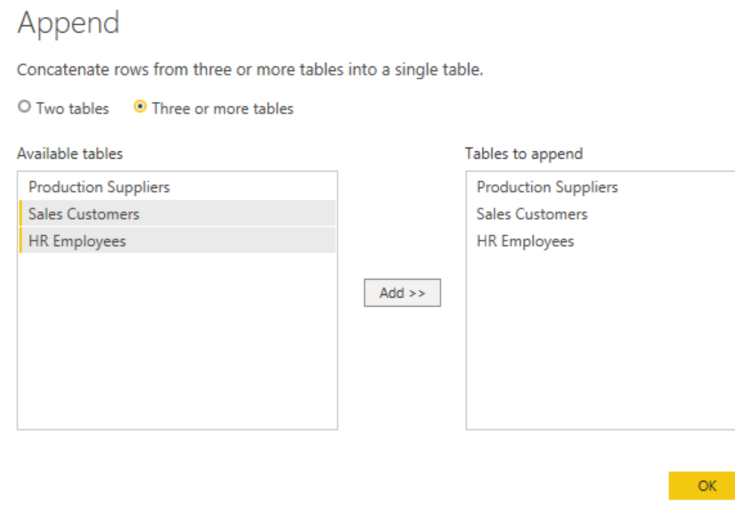
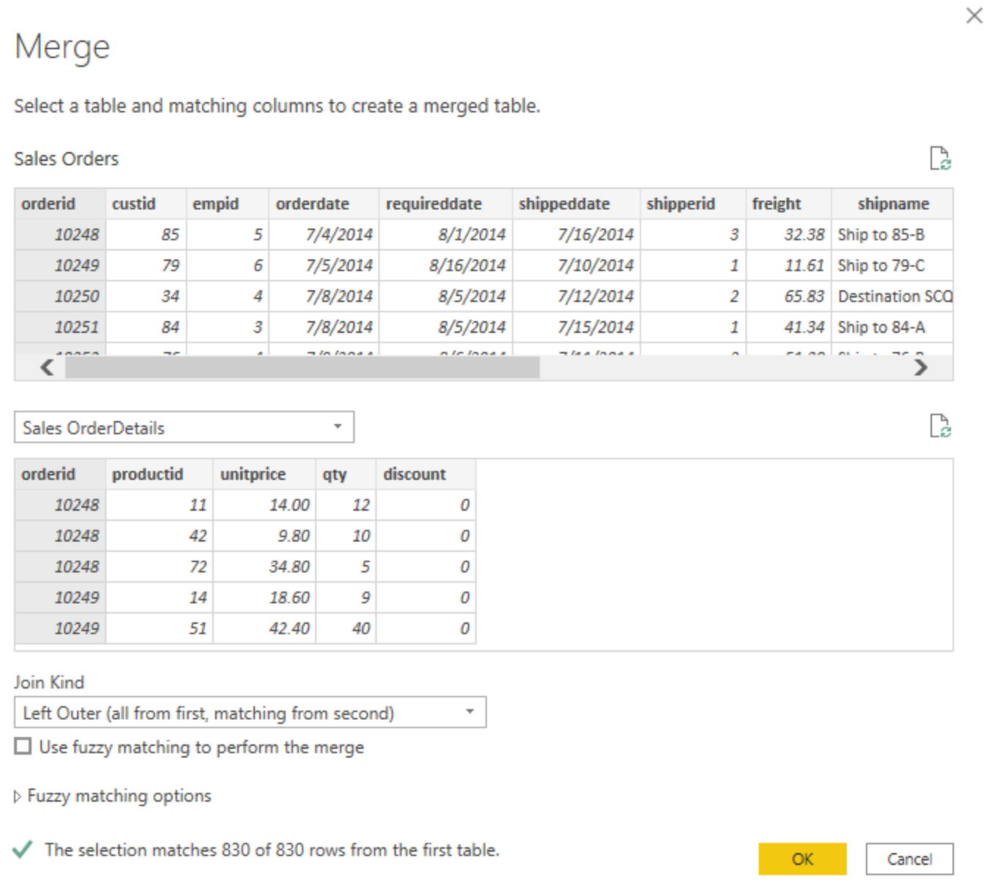
Combine multiple queries into one
Append
Merge
Notes:
The ability to combine queries is powerful because it allows you to append or merge different tables or queries together. You can combine tables into a single table in the following circumstances:
Too many tables exist, making it difficult to navigate an overly-complicated data model.
Several tables have a similar role.
A table has only a column or two that can fit into a different table.
You want to use several columns from different tables in a custom column.
You can combine the tables in two different ways: merging and appending.
Append:
When you append queries, you will be adding rows of data to another table or query. For example, you could have two tables, one with 300 rows and another with 100 rows, and when you append queries, you will end up with 400 rows. Append queries will NOT remove duplicates.
If the columns in the source queries are not exactly matched: Append works best when the columns match exactly. if columns in source queries are different, append still works, but will create one column in the output per each new column, if one of the sources doesn’t have that column the cell value of that column for those rows will be null.
Merge:
When you merge queries, you are combining the data from multiple tables into one based on a column that is common between the tables. This process is similar to the JOIN clause in SQL. Essentially, you will be adding columns from one table (or query) into another. To merge two tables, you must have a column that is the key between the two tables.
You can also choose how to join the two tables together, a process that is also similar to JOIN statements in SQL. These join options include:
Left Outer - Displays all rows from the first table and only the matching rows from the second.
Full Outer - Displays all rows from both tables.
Inner - Displays the matched rows between the two tables.

Slide 22
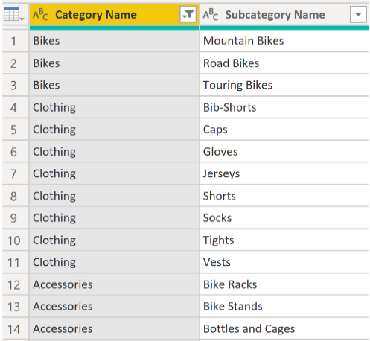
Unpivot or pivot columns
Add or remove table structure to meet your aggregation needs.
Notes:
Unpivot columns
If we unpivot the table, we are taking all distinct rows in category name and turning them into columns.
Unpivoting is a useful feature of Power BI. You can use this feature with data from any data source, but you would most often use it when importing data from Excel. Unpivoting streamlines the process of creating DAX measures on the data later. By completing this process.
If the data that you are shaping is flat (in other words, it has lot of detail but is not organized or grouped in any way), the lack of structure can complicate your ability to identify patterns in the data. You can use the Pivot Column feature to convert your flat data into a table that contains an aggregate value for each unique value in a column.
Pivot columns
If the data that you are shaping is flat (in other words, it has lot of detail but is not organized or grouped in any way), the lack of structure can complicate your ability to identify patterns in the data.
You can use the Pivot Column feature to convert your flat data into a table that contains an aggregate value for each unique value in a column. For example, you might want to use this feature to summarize data by using different math functions such as Count, Minimum, Maximum, Median, Average, or Sum.

Slide 23
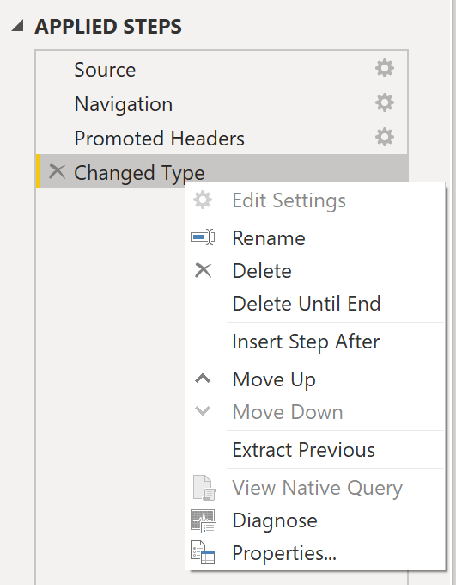
Query folding
Pushes data transformations to the source for better performance and efficiency.
Supported sources
Relational databases
OData feeds
Active Directory
Notes:
Simply put, Query Folding means that the Power BI Desktop engine doesn’t have to “do the work” for certain transformations; it’s done on the native data source and then brough to Power BI.
A good guideline to remember is that if you can translate a transformation into a Select SQL statement, which includes operators and clauses such as GROUP BY, SORT BY, WHERE, UNION ALL, and JOIN, you can use query folding.
If the View Native Query option is not available (not displayed in bold type), that query folding is not possible for this step, and you will have to work backward in the Applied Steps area until you reach the step in which View Native Query is available (displays in bold type). This process will reveal the native query that is used to transform the dataset.
Native queries are not possible for the following transformations:
Adding an index column
Merging and appending columns of different tables with two different sources
Changing the data type of a column
Running complex DAX functions

Slide 24
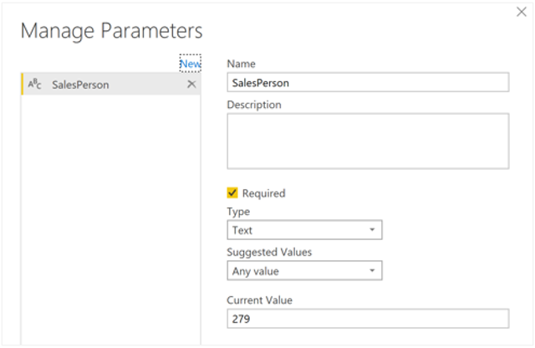
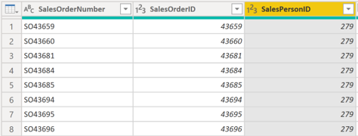
Dynamic reports with parameters
Notes:
You can use parameters by determining the values that you want to see data for in the report, and the report updates accordingly by filtering the data for you.
Imagine in a sales analysis report, a use case for setting a parameter on the salesperson ID would be to enable personalized analysis for different salespeople.
By creating a parameter for the salesperson ID, users can select a specific salesperson from a dropdown menu or slicer in the Power BI report.
The parameter value is then used in Power Query to filter the sales data to include only transactions associated with the selected salesperson. This allows users to focus on individual sales performance, compare salespeople, and gain insights into their respective contributions to overall revenue and customer acquisition.

Slide 25
Performance recommendations
Only keep necessary data
Check data types
Reduce cardinality
Disable query load
Use parameters
Notes:
Only keep necessary data
Not all data will be used later, so trim it now if you can. Otherwise, go back and remove it when you know it’s unnecessary.
Check data types
Last thing before loading, always check data types! Use integers for ids instead of strings, and use dates instead of datetimes, if possible.
Reduce cardinality
Cardinality is how many unique values there are in a column. The more unique values (higher cardinality), the worse the performance.
Enable/disable load
Not all data needs to be reloaded every time you refresh the data. This can improve performance.
Group queries in Power Query Editor
Grouping allows logical separation when you have a lot of queries.
Right-click query > select Move to group.
Use parameters
Store values for reuse in transformations.

Slide 26
DEMO
Clean, transform, and load data in Power BI

Slide 27
Lab: Load data in Power BI Desktop
In this lab, you’ll apply transformations to each of the queries created in the previous lab. You’ll then apply the queries to load each as a table to the data model.
In this lab you learn how to:
Apply various transformations
Apply queries to load them to the data model

Slide 28
Knowledge check: clean and transform data
What is a risk of having null values in a numeric column?
That function SUM of data are incorrect.
That function MAX of data will be incorrect.
That function AVERAGE of data will be incorrect.
If you have two queries that have different data but the same column headers, and you want to combine both tables into one query with all the combined rows, which operation should you perform?
Append
Merge
Combine
Notes:
Use the slide animation to reveal the correct answers.

Slide 29
Recap
In this section, we covered:
Connecting to various data sources.
Determining the right storage mode.
Profiling data for accuracy and insights.
Cleaning, transforming, and loading data.
Using Query Folding for appropriate sources.
Recommendations for more performant reports.

Slide 30
Thanks
Resources
Prepare data for analysis
Clean, transform, and load data in Power BI

